Slide 1
Asynchronous JavaScript and XML (AJAX) & JSON

Slide 2
JSON
JavaScript Object Notation
Notes:
Lets talk about JSON ? What is JSON

Slide 3
JavaScript Object Notation
A way to represent JavaScript data
for data interchange
lightweight
human readable (i.e. text-based)
Consists of two data structures:
Collections
A collection of "name" : "value" pairs (an object)
Arrays
a list of values or objects (including arrays)

Slide 4
JSON
JavaScript Object Notation
www.json.org
Subset of object-literal notation
All JSON is valid object-literal notation...
JSON is a data interchange format, functionally similar to XML

Slide 5
XML like so...
<?xml version="1.0" encoding="UTF-8“ ?> <book id="0375411275"> <author>Ben Rice</author> <title>Pobby and Dingan</title> <copyright>2000</copyright> <publisher>Knopf</publisher> <genre>General Fiction</genre> <isbn>0375411275</isbn> </book>

Slide 6
JSON like so.
{ "book" : { "id" : "66458301", "author" : "Ben Rice", "title" : "Pobby and Dingan", "copyright" : "2000", "publisher" : "Knopf", "genre" : "General Fiction", "isbn" : "66458301" } }

Slide 7
JSON: Example
Can be just a collection of "name" : "value" pairs
{
"name": ”Thilanka",
"rin": 661111111,
"profession": ”Lecturer",
"staff": true,
"hair colors": [”Black", ”Brown", ”Gray"]
}

Slide 8
Even Simpler JSON
Can be just a collection of "name" : "value" pairs
{ "givenNames": "John", "lastName": ”Doe", "yearOfBirth": "1667", "yearOfDeath": "1745" }

Slide 9
Basic JSON Format
curly braces
wrap collections
all text must be
double quoted
{ "book" : { "id" : "66458301", "author" : "Ben Rice", "title" : "Pobby and Dingan", "copyright" : "2000", "publisher" : "Knopf", "genre" : "General Fiction", "isbn" : "66458301" } }
comma after
each entry
no comma before
final curly brace

Slide 10
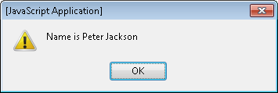
JSON as a Variable
You can assign JSON to a variable in JavaScript var name = {"first":"Peter","last":"Jackson"};
and access its values using dot notation alert("Name is " + name.first + " " name.last);

Slide 11
JSON
Objects are encased in { }
Contain comma-delimited string: value pairs
Possible values:
Array (comma-delimited values, wrapped in [ ])
Object
String
Number
Boolean
null

Slide 12
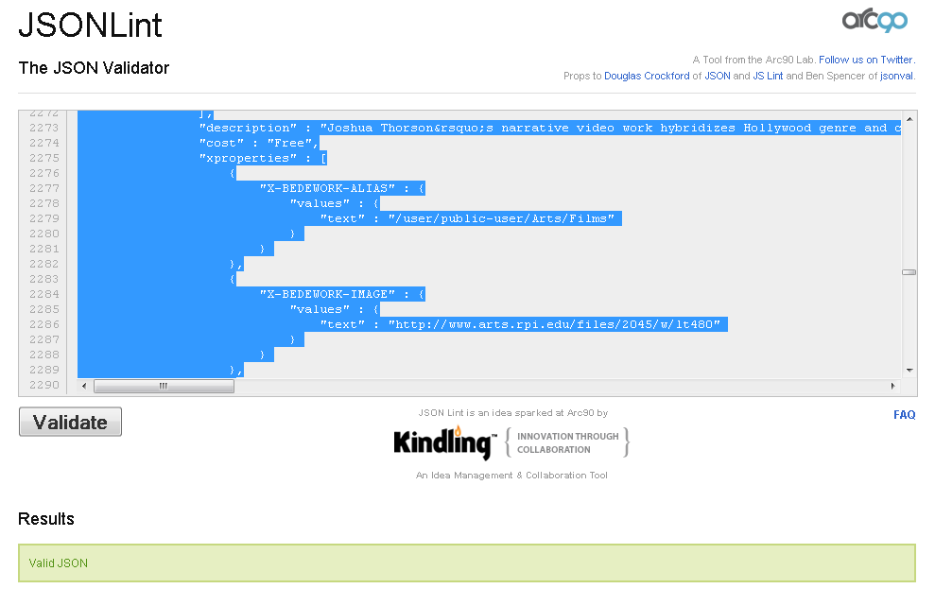
JSON Validation
JSON Lint: http://www.jsonlint.com/

Slide 13
JSON with an Array
{ "books" : [ { "author" : "Ben Rice", "title" : "Pobby and Dingan" }, { "author" : "Stewart O'Nan", "title" : "Last Night at the Lobster" } ] }

Slide 14
JSON: Advantages
Easy to work with in JavaScript
Human-readable and machine-readable
Often lighter than XML
Potentially less-descriptive
Typically used when XML Namespaces and Schema are not needed

Slide 15
<aside> XML Schema
Alternative to DTDs for XML, written in XML themselves
Uses its own namespace: http://www.w3.org/2001/XMLSchema
Can supply much more information than DTDs:
default values
number/order of elements
valid nesting order
data types for elements, attributes

Slide 16
Same Origin Policy (SOP)
The same origin policy is a security constraint that prevents scripts from one site accessing methods or properties in scripts from another.
It allows web pages to execute only those methods in scripts with the same scheme, host, and port.
What does that mean to you practically?
Cookies and web pages from different sites are isolated one from another (this is a good thing)
XMLHttpRequest won't work cross-domain
You will want to cache data locally (e.g. json)
You may sometimes want to use special tricks (e.g. jsonp) to dynamically load a remote script (caching is often better)
We'll touch on some of these topics more when we discuss security.
HTML 5 specifies a means of passing simple messages between windows of different origins (see https://developer.mozilla.org/en/DOM/window.postMessage )

Slide 17
AJAX
Asynchronous JavaScript and XML
Allows a browser to request data from a server "behind the scenes" without reloading the entire page
Built on XMLHttpRequest (XHR)
An API introduced by Microsoft in 1999-2000 to help support their development of Outlook Web Access
Picked up by all major browsers shortly thereafter
Popularized by Google with Google Maps and Gmail
W3C picked it up as a working draft in 2006
Notes:
AJAX stands for Asynchronous JavaScript And XML.
AJAX is not a programming language.
AJAX is a technique for accessing web servers from a web page.

Slide 18
AJAX Concepts
Asynchronous
during a synchronous request, all scripting and other activities on a web page stop until the full request/response cycle is complete
an asynchronous request happens behind the scenes – a user can continue interacting with a web page, scripts can run, all while waiting for the response
JavaScript
the engine that provides the XMLHttpRequest API
XML

Slide 19
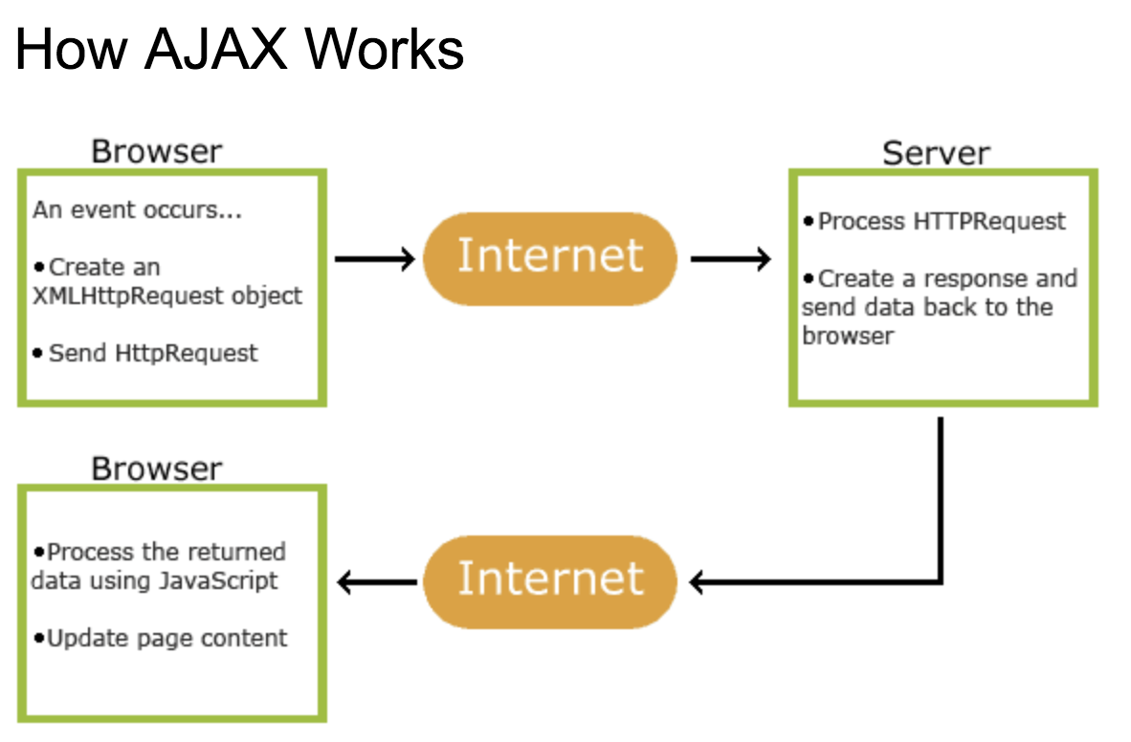
Source: https://www.w3schools.com/js/js_ajax_intro.asp

Slide 20
jQuery & AJAX
jQuery provides a number of high-level AJAX methods that handle cross-browser support and simplify the use of XMLHttpRequest
load(), $.getJson(), $.getScript(), $.get(), $.post() For an introduction to these techniques, see: http://net.tutsplus.com/tutorials/javascript-ajax/5-ways-to-make-ajax-calls-with-jquery/
often use the most fundamental & flexible method, jQuery's low-level AJAX implementation: $.ajax()
See: http://api.jquery.com/jQuery.ajax/

Slide 21
AJAX : Methodology
Origin http://www.adaptivepath.com/ideas/ajax-new-approach-web-applications/
“Ajax isn’t something you can download. It’s an approach—a way of thinking about the architecture of web applications using certain technologies.” (Garrett, 2005)

Slide 22
AJAX : Methodology
AJAX Components:
Semantic markup
CSS
Document Object Model
(A)synchronous HTTP requests using XMLHttpRequest object
All of the above are driven by JavaScript
Requests happen after the page has already loaded

Slide 23
XMLHttpRequest: History
Originated at Microsoft
Underlying tech predates IE5!
Mozilla implemented something similar in the Gecko engine
Other major browsers followed suit, became a de facto standard
W3C published a working draft detailing the spec, making it official ~2006
All implementations now use the XMLHttpRequest object

Slide 24
XMLHttpRequest
Not restricted to requests/responses in XML
Methods are invoked on the object to...
Prepare the request
Send the request
Wait for a response
Process the response
var xhr = new XMLHttpRequest();
Reading Material : https://www.w3schools.com/js/js_ajax_http.asp
Notes:
Not restricted to requests/responses in XML … this is not only for the XML, it is possible to use JSON with this.
Xhr is an Object

Slide 25
XMLHttpRequest: Prepare
Initialize the request:
xhr.open(method, url, async, [username], [password])
method – HTTP method to use (GET, POST, PUT, DELETE)
url – Request target
async – Boolean determining whether other processing can happen in the background (you want this to be true)
username/password – Used if the request requires basic authentication

Slide 26
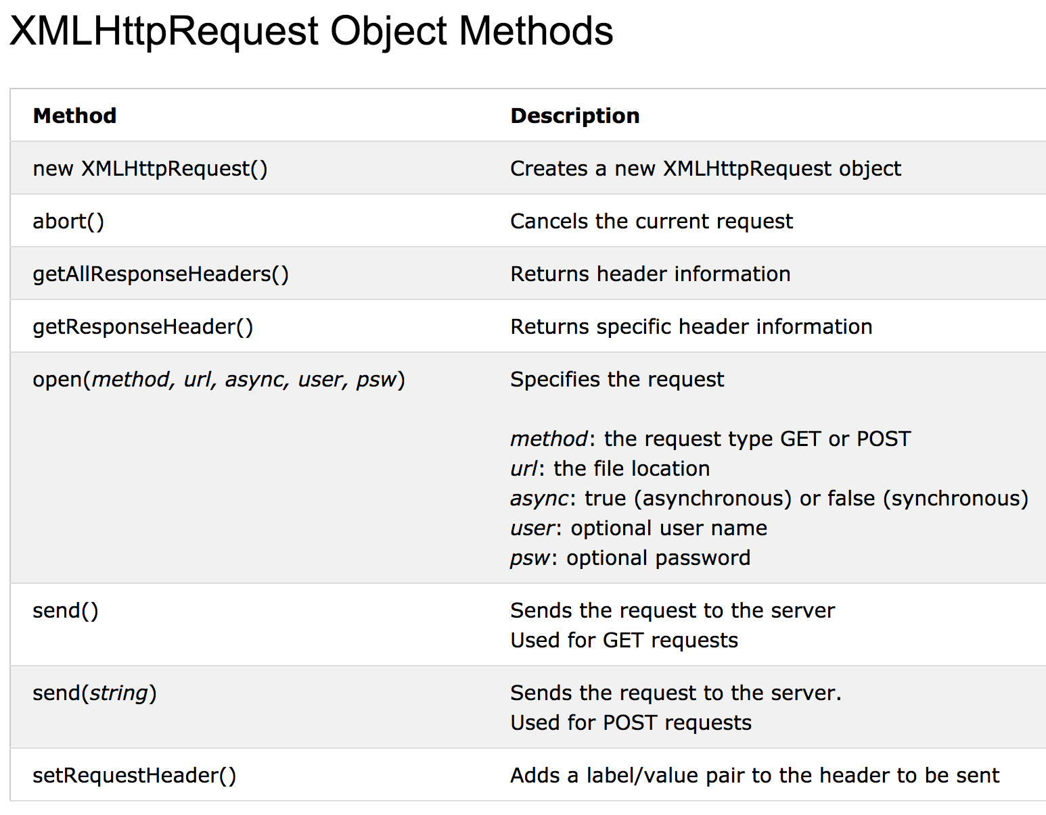
Resource: https://www.w3schools.com/js/js_ajax_http.asp

Slide 27
XMLHttpRequest: Prepare
xhr.setRequestHeader(name, value)
Sets the name-value pair for a header to be appended to this request
Can be any header valid for an HTTP request
Reading material: https://www.w3schools.com/js/js_ajax_http.asp
Notes:
This Sets the name-value pair for a header to be appended to this request
It Can be any header valid for an HTTP request

Slide 28
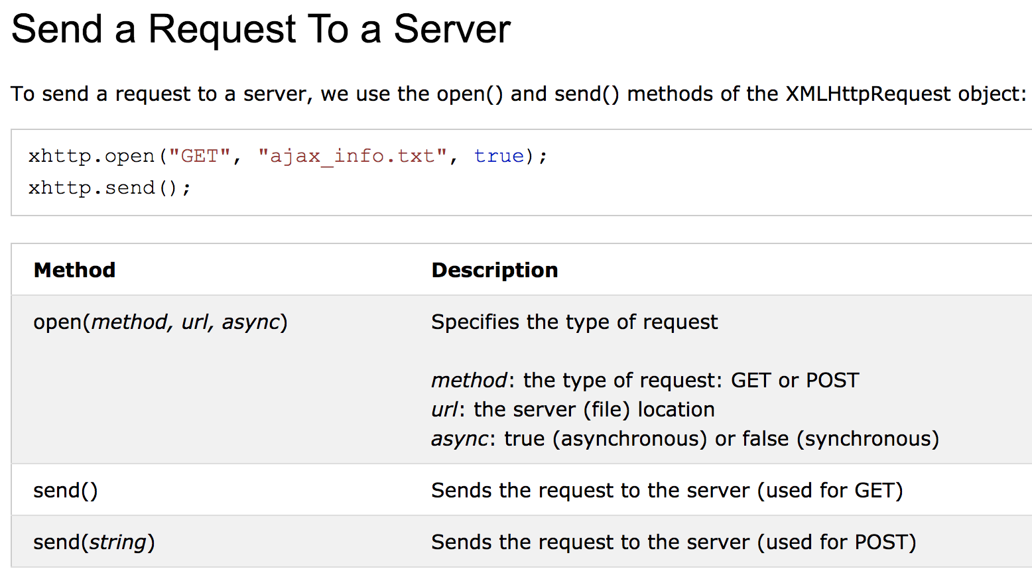
XMLHttpRequest: Send
xhr.send([data])
Sends the prepared request
data becomes the request body (if necessary)
Reading material: https://www.w3schools.com/js/js_ajax_http_send.asp
Notes:
This Sends the prepared request

Slide 29
The onreadystatechange Property
With the XMLHttpRequest object you can define a function to be executed when the request receives an answer.
The function is defined in the onreadystatechange property of the XMLHttpResponse object:
Reading material: https://www.w3schools.com/js/js_ajax_http_send.asp

Slide 30
XMLHttpRequest: Listen
xhr.onreadystatechange – event listener invoked if async was true
Fires if the readyState property of XMLHttpRequest object changes
xhr.readyState – property detailing the state of processing the request via 4 constants
1 – open() invoked successfully
2 – send() invoked successfully, response headers received
3 – loading response body
4 – response fully received (complete)
Example: https://www.w3schools.com/js/tryit.asp?filename=tryjs_ajax_first
Notes:
readyState – property detailing the state of processing the request via 4 constants

Slide 31
XMLHttpRequest: Listen
xhr.status – Property holding the numeric HTTP
status code for the request
Set after readyState == 4
Recall that 200 means “OK”

Slide 32
XMLHttpRequest: Response
xhr.responseXML – Property containing HTTP response as a Document object
xhr.responseText – Property containing the raw response body of the HTTP response
HTML
XML
JSON

Slide 33
To check the status of a document on the server:
function fetchStatus(address) {
var client = new XMLHttpRequest();
client.onreadystatechange = function() {
// in case of network errors this might not give reliable results
if(this.readyState == this.DONE)
returnStatus(this.status);
}
client.open("HEAD", address);
client.send();
}
Notes:
This is a sample code to check the status of a document on the server.

Slide 34
To log a message to the server:
function log(message) {
var client = new XMLHttpRequest();
client.open("POST", "/log");
client.setRequestHeader("Content-Type", "text/plain;charset=UTF-8");
client.send(message);
}

Slide 35
AJAX in jQuery
jQuery (like many libraries) can handle many of these details for you
Eliminates cross-browser issues
Handles listeners consistently
Syntax often more intuitive (“write less, do more”)
Notes:
It eliminates cross-browser issues
It handles listeners consistently
Syntax often more intuitive

Slide 36
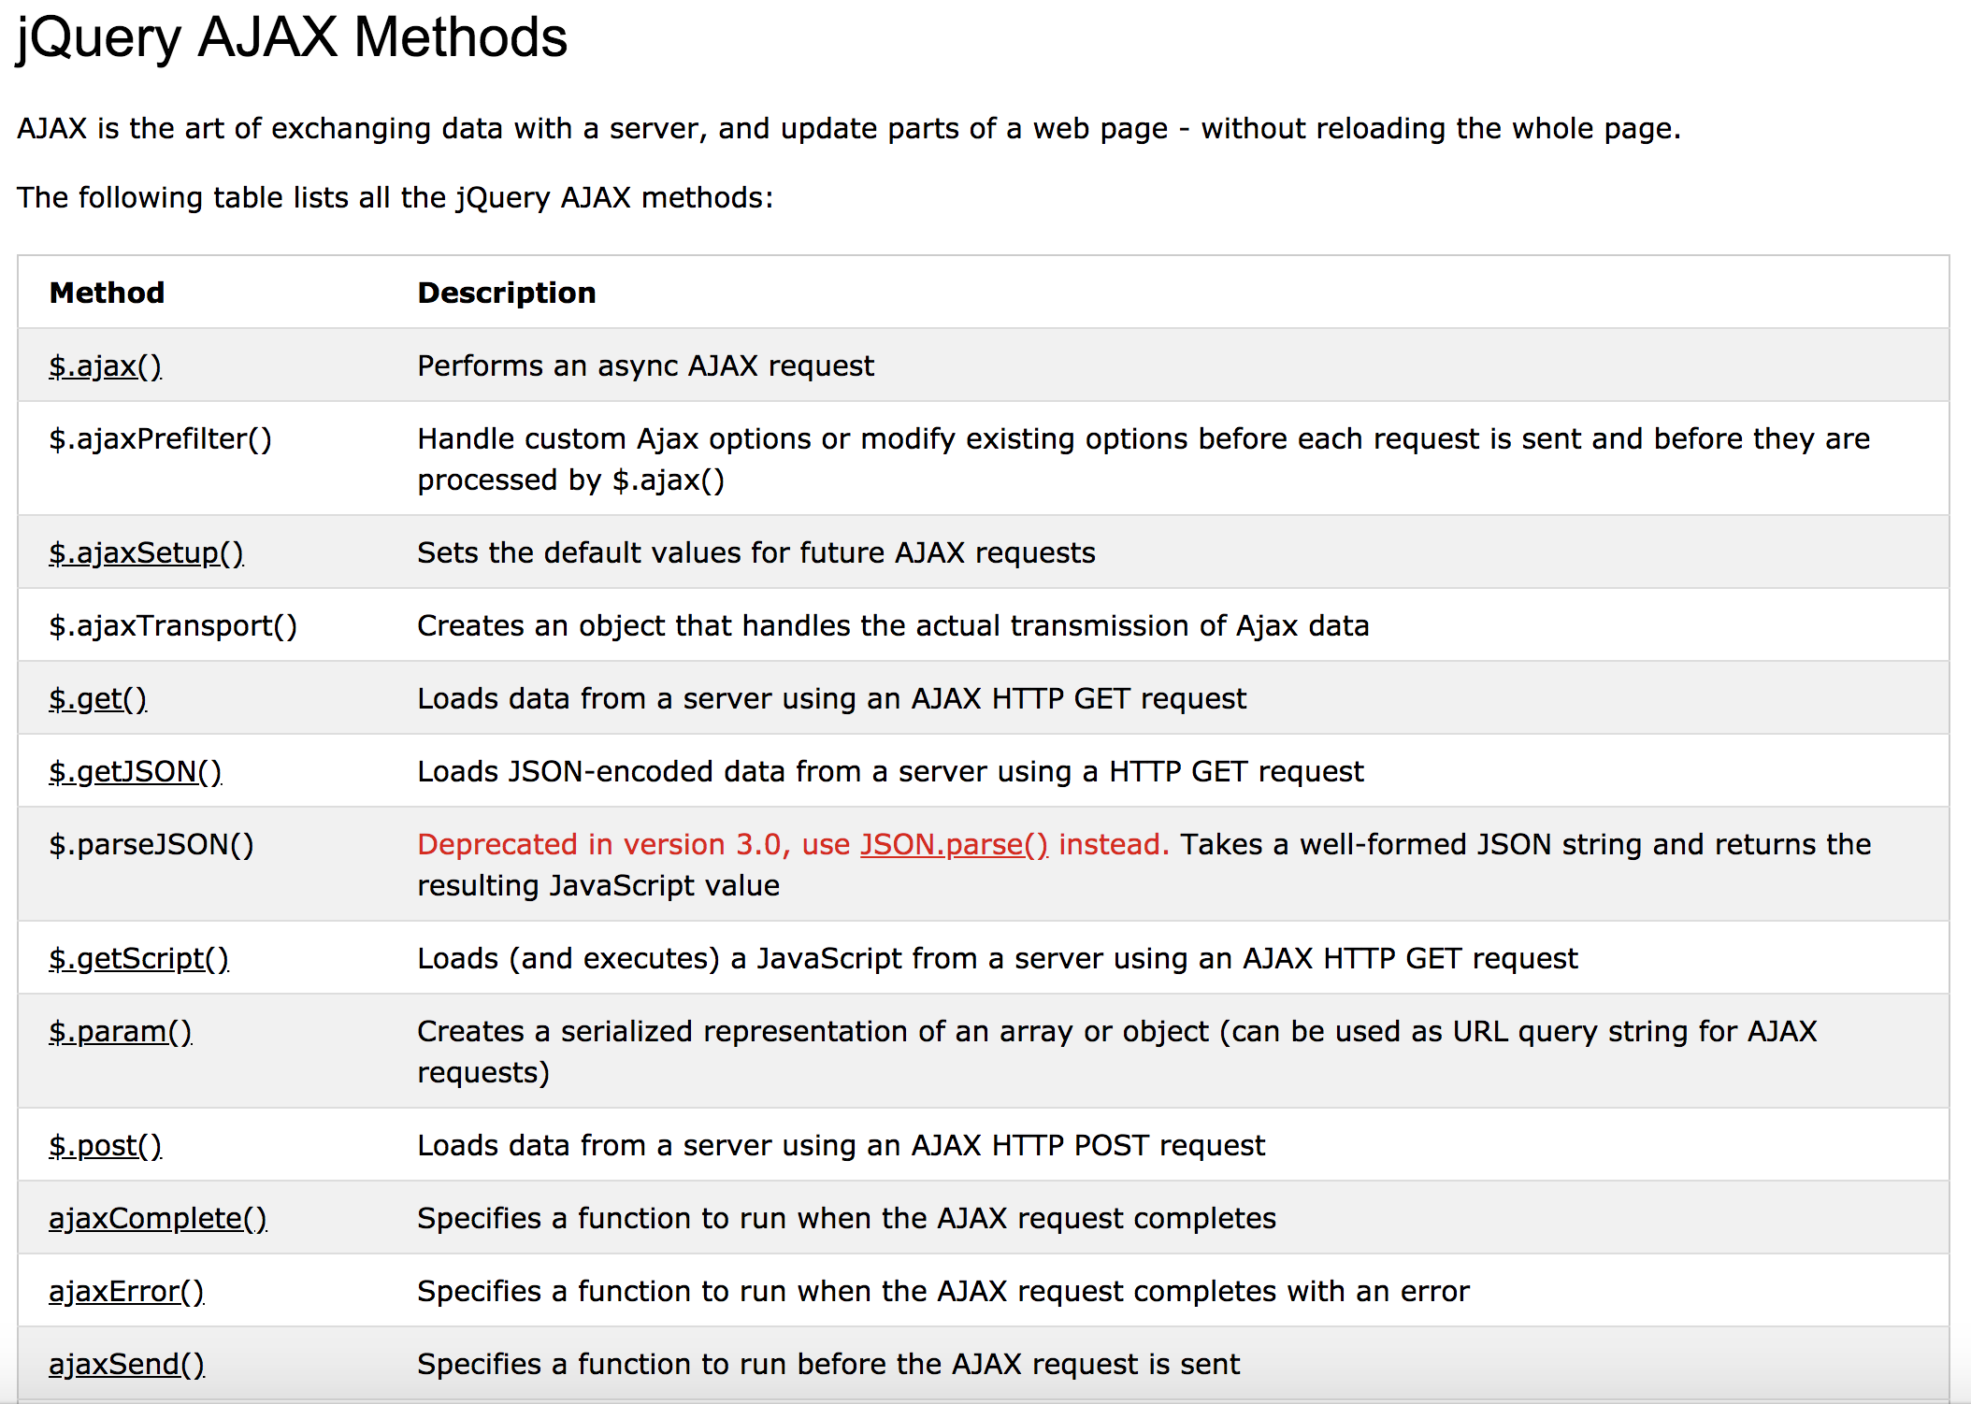
https://www.w3schools.com/jquery/jquery_ref_ajax.asp

Slide 37
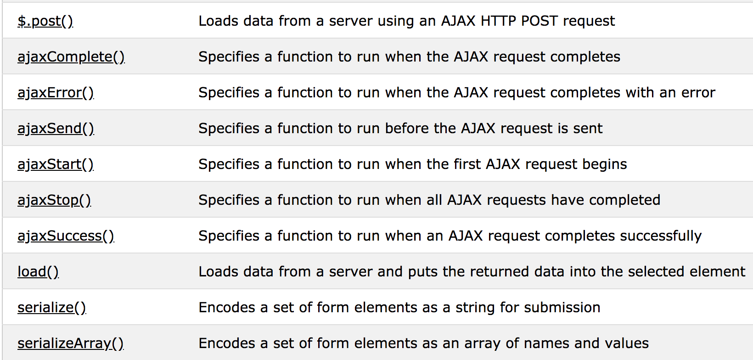
Jquery AJAX Methods
https://www.w3schools.com/jquery/jquery_ref_ajax.asp

Slide 38
AJAX in jQuery: .load()
$(selector).load(url[, data][, callback])
Make an AJAX request to url, passing data (string, object-literal key:value pairs) as the request body
Replaces the contents of selector with the response body received
callback is fired when the request is complete
https://www.w3schools.com/jquery/jquery_ajax_load.asp
Notes:
Make an AJAX request to url, passing data (string, object-literal key:value pairs) as the request body

Slide 39
AJAX in jQuery: .get()
$.get(url[, data][, callback][, dataType])
Method of jQuery (no selector)
Replacement doesn't take place by default
dataType defaults to best-guess, but can be used if expecting data of a certain type
jqXHR Object returned, not the response itself
Anything with the response should be done with the callback
Reading Material: https://www.w3schools.com/jquery/jquery_ref_ajax.asp
Notes:
Loads data from a server using an AJAX HTTP GET request

Slide 40
AJAX in jQuery: .post()
$.post(url[, data][, callback][, dataType2])
As .get(), except the request is made using the POST verb
Refer to Lecture #1 for the difference between each of the HTTP verbs
Reading material: https://www.w3schools.com/jquery/jquery_ref_ajax.asp
Notes:
Loads data from a server using an AJAX HTTP POST request

Slide 41
AJAX in jQuery: .getJSON()
$.getJSON(url[, data][, callback])
As .get(), except...
dataType is always “json”
$.parseJSON() is called on the result before it is passed to the callback, to ensure valid JSON is being used
$.getJSON('test.json', function(data) {
// We can access data using object syntax alert(data.name + ", what is your profession?"); alert(data.profession + "!");
});
Notes:
Loads JSON-encoded data from a server using a HTTP GET request

Slide 42
AJAX in jQuery: .ajax()
Lowest-level AJAX function
All other functions are shorthand for specific .ajax() calls
Necessary for...
Other HTTP verbs (PUT, DELETE)
Advanced error handling
Manipulating headers
Any other situation where you require finer control over the request/response format

Slide 43
AJAX in jQuery: .ajax()
$.ajax([url][, settings])
$.ajax([settings])
url is where the request should be made
settings is a series of key:value pairs, where you can set...
Event handlers
HTTP headers
And more: http://api.jquery.com/jQuery.ajax/
Notes:
Performs an async AJAX request

Slide 44
</class>
Lab 4 is on AJAX and JSON.
divs and spans are perfectly fine, as long as you're sure there's nothing better to use.

